Slide 1
Low-Level RF System Development for EIC Crab Cavities
October 15th , 2025
Freddy Severino,
RF Systems Head, Collider Accelerator Department
EIC RF Controls Technical Lead

Slide 2
Outline
Introduction
EIC Crab Systems Overview
RF Control Specification
RF Noise
Impedance
Crabbing closure
RF Control Hardware
Low-Level RF Control Solution
RF Noise
Impedance
RF Control Global Plan
Summary Status

Slide 3
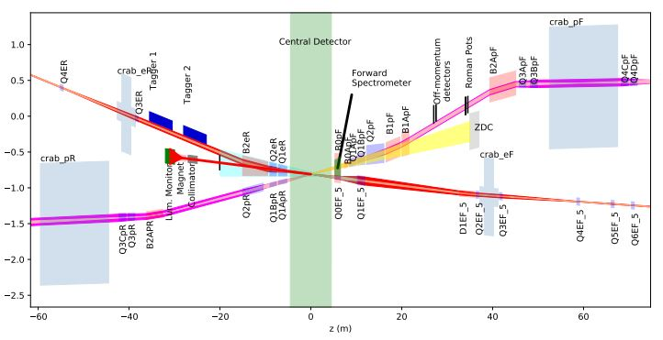
Introduction
The Electron Ion Collider (EIC) beams will collide with a large (25 mrad) crossing angle to separate electron and proton beam quickly and limit beam-beam effects [1].
The large crossing angle provides space for a neutron detector in the forward hadron direction, and for the luminosity detector in the forward electron direction.
Collisions with a crossing angle reduce the overlap region of the colliding bunches, which reduces the luminosity by an order of magnitude for 25 mrad [1].
The resulting luminosity loss will be largely restored by rotating the bunches around the vertical axis at the IP (perpendicular to the crossing plane) by half the crossing angle using transversely deflecting RF resonators, or crab cavities, in both the hadron and electron rings[1].
Schematic layout of the interaction region, EIC Conceptual Design Report

Slide 4
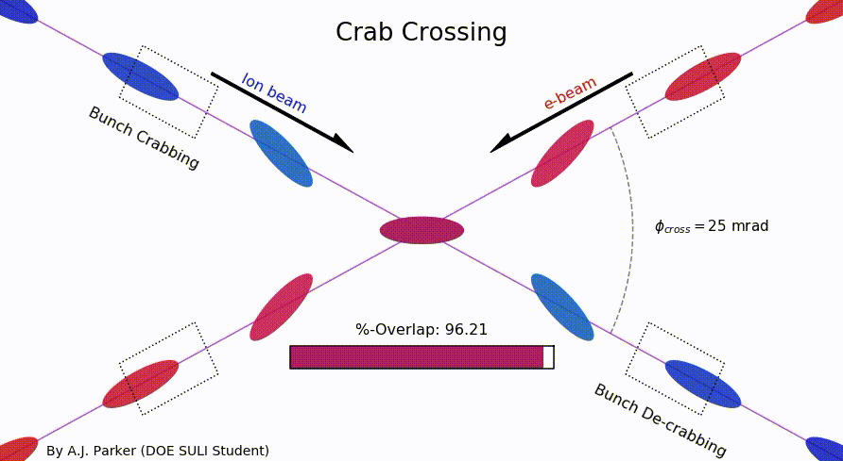
Crab crossing to recover head-on collisions
Crab-cavities:
Crabs apply head and the tail transverse kick to proton and electron bunches in opposite directions (in the plane of the crossing angle).
Correct for crossing angle effects
Restore head-on collision
Achieve maximum luminosity
S.U. De Silva et. al. MOPAB393 IPAC2021 (2021)
Without
Crabbing
With
Crabbing

Slide 5
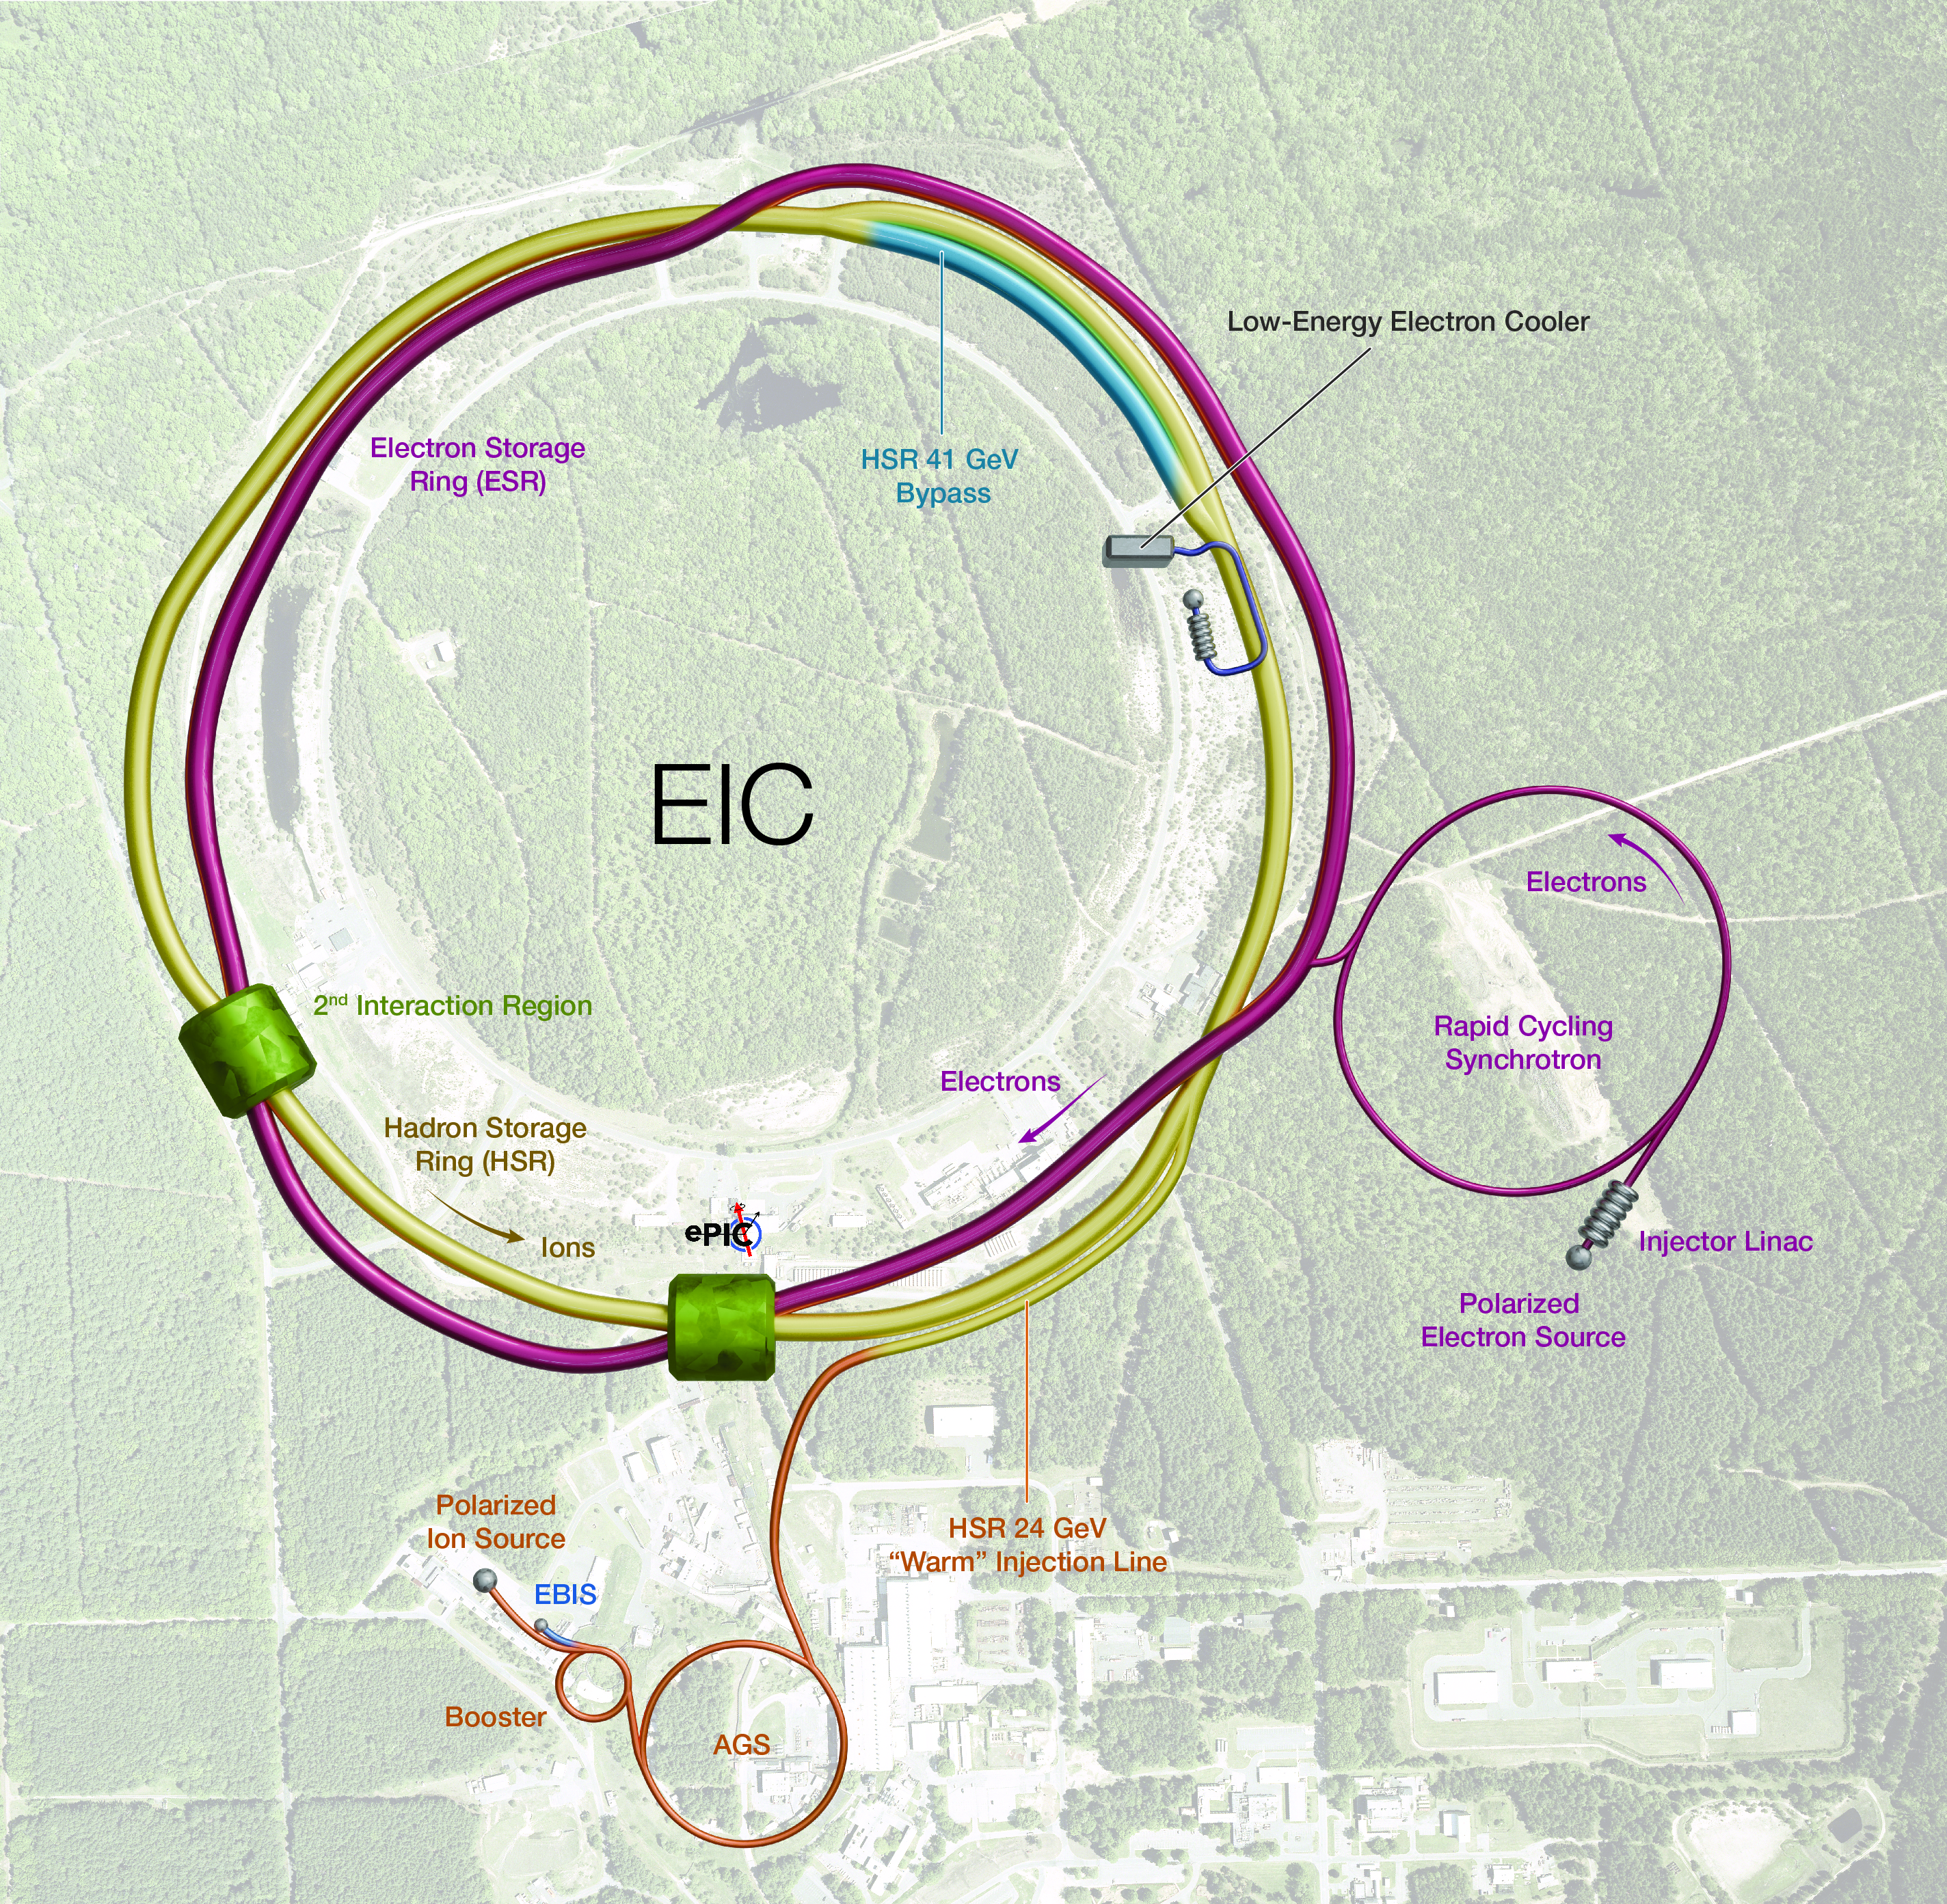
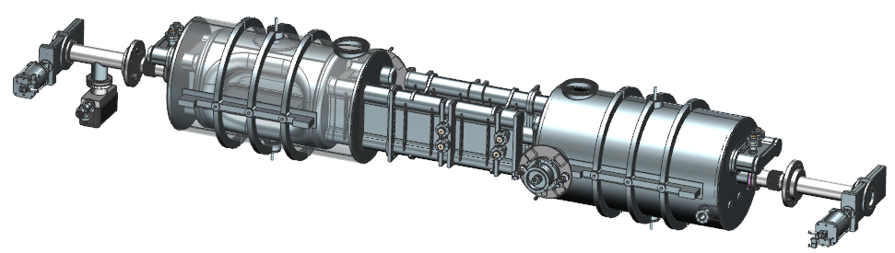
EIC Crab Cavity Overview
Binping Xiao
Crab Cavities (IR6) | HSR (Cavities/CMs) | ESR (Cavities/CMs)
197 MHz | 8/4 | –
394 MHz | 4/4 | 2/2*
*or 4/4 for redundancy
HSR: Hadron Storage Ring
ESR: Electron Storage Ring
For 197MHz crab cavity
Operating voltage per cavity: 8.5 MV.
Designed specs: 11.5MV per cavity.
2 cavities in 1 cryomodule.
N. Huque
5
Notes:
Low in freq -> large in size, geometric constraint/mechanical design/fabrication/surface treatment/installation.
Tight impedance budget, high HOM power -> difficulties in damper designs.
for EIC, the longitudinal impedance budget is two orders of magnitude lower comparing with HL-LHC for 197MHz and three or-ders of magnitude lower for 394MHz, while the transverse impedance budget is one order of magnitude lower for both 197MHz and 394MHz.
Due to the high current and short bunch length, especially for electron bunch, the HOM power of both 197MHz and 394MHz systems are high while comparing with HL-LHC.

Slide 6
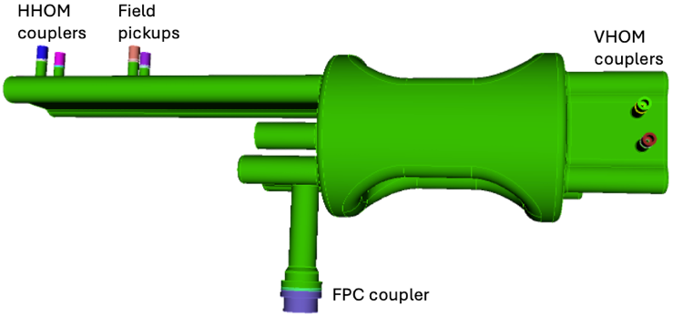
EIC 197 MHz Crab Cavity
S. De Silva
Two field probes designed to extract 5 W each at 11.5 MV.
One FPC port
47 kW with 50 Hz microphonics and 0.6 mm beam offset, 1.75e6 FPC Q_{ext}, 11.5 MV crabbing voltage, 1 A beam.
RF Property | Value
V_{t} [MV] | 8.5 | 11.5
E_{p} [MV/m] | 33.2 | 44.9
B_{p} [mT] | 60.1 | 81.3
Total V_{t} [MV] | 34
No. of cavities | 4 | 3
Operating Temp. [K] | 2.05
Stored Energy [J] | 50.3 | 92
R_{s} [Ω] (R_{BCS} = 0.4 nΩ) | 15
P_{diss} [W] | 9.6 | 17.6
Q₀ (G = 97.2 Ω) | 6.48×10⁹
6

Slide 7
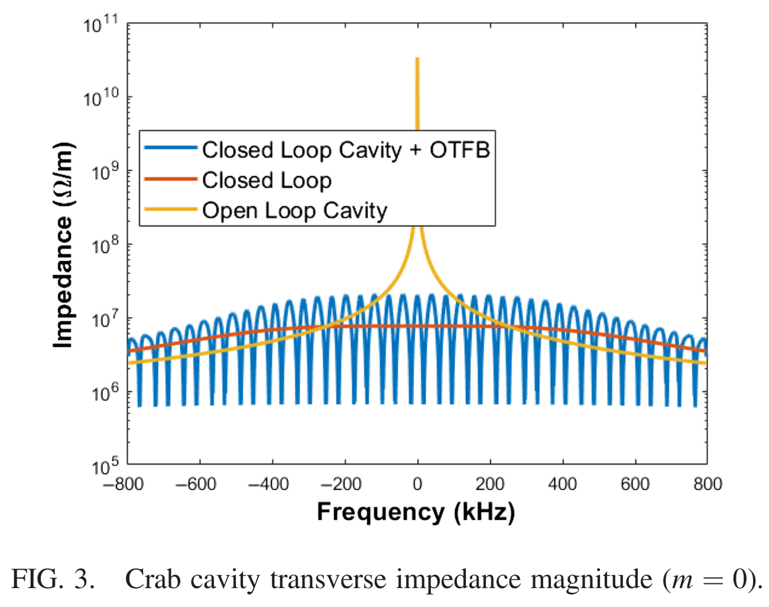
Crab RF Specification: Impedance Reduction
Impedance Reduction Crab RF Systems:
The fundamental mode of the crab cavity presents a large transverse impedance.
The large transverse impedance coupled with large beta can lead to very strong transverse instabilities [2,3].
Themis Mastoridis
Fc | 197 MHz
Cavity Impedance | 4.2e9 Ohms/m
Qext | 1.75e6
RoverQ | 2400 ohms/m Cir Def
Effective Q | 300
Fast-Feedback | Gain ~ 3000.
Feedback Gain to reduce cavity impedance:
High-gain feedback (68 dB).
One-turn delay (20 dB) @ betatron side-bands.
88 dB total impedance reduction required [1,2].

Slide 8
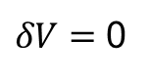
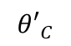
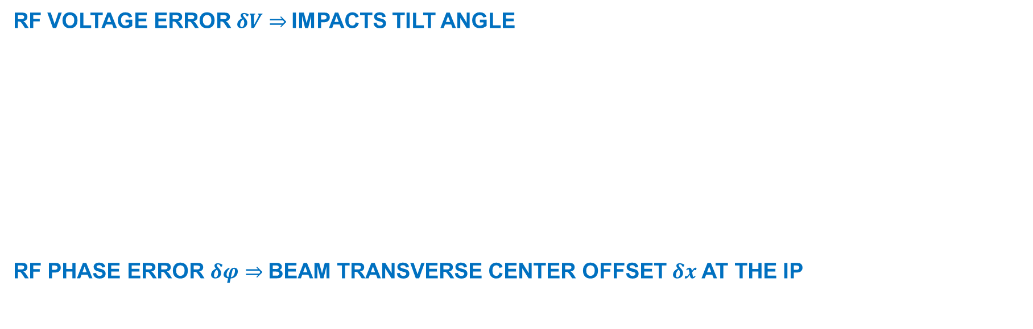
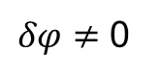
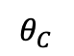
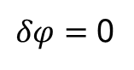
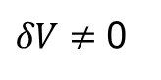
Effect of Crab System’s RF noise
S. Verdú-Andrés (BNL) | Crab Cavities for Colliders
RF VOLTAGE ERROR $δV⇒$IMPACTS TILT ANGLE
RF PHASE ERROR $δφ⇒$BEAM TRANSVERSE CENTER OFFSET $δx$AT THE IP
$$θ_{C}$$
At the IP:
$${θ′}_{C}$$
$δV=$ 0
$δV≠$ 0
Full overlap
Partial overlap
$⇒$Over or under compensation of crossing angle prevents full head-on recovery
At the IP:
$δφ=$ 0
$δφ≠$ 0
$⇒L$eads to a shift on bunch centroid position
Notes:
A crab cavity is just a deflecting cavity operated in zero-voltage crossing phase; any phase error makes the crab cavity impart a combined crabbing plus deflecting kick.
Fast phase modulations (100 ps peak to peak) will introduce sinusoidal bunch distortions.
0.007 deg = 1e-4 rad for KEKB crab cavity system (see Morita’s talk)

Slide 9
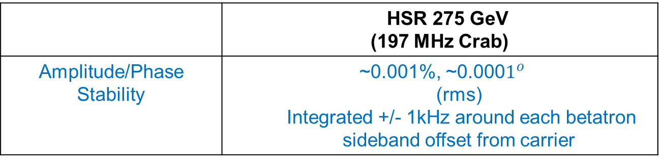
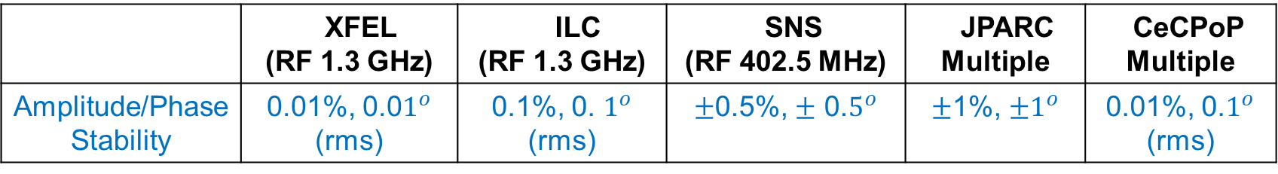
Crab RF Specification: Field Regulation
The stability requirement varies in different accelerator.
The requirement on amplitude / phase stability differs by time scale, short term, medium term, long term (minutes to hours). It is often specified as an rms value but peak to peak is also used.
HSR Crab Systems stability requirements? Under development
Target (HSR 275 GeV) →
 | XFEL (RF 1.3 GHz) | ILC (RF 1.3 GHz) | SNS (RF 402.5 MHz) | JPARC Multiple | CeCPoP Multiple
Amplitude/Phase Stability | 0.01%, 0.0$1^{o}$ (rms) | 0.1%, 0. $1^{o}$ (rms) | $±$0.5%, $±$ 0.$5^{o}$ | $±$1%, $±1^{o}$ | 0.01%, 0.$1^{o}$ (rms)
 | HSR 275 GeV (197 MHz Crab)
Amplitude/Phase Stability | ~0.001%, ~0.000$1^{o}$ (rms) Integrated +/- 1kHz around each betatron sideband offset from carrier

Slide 10
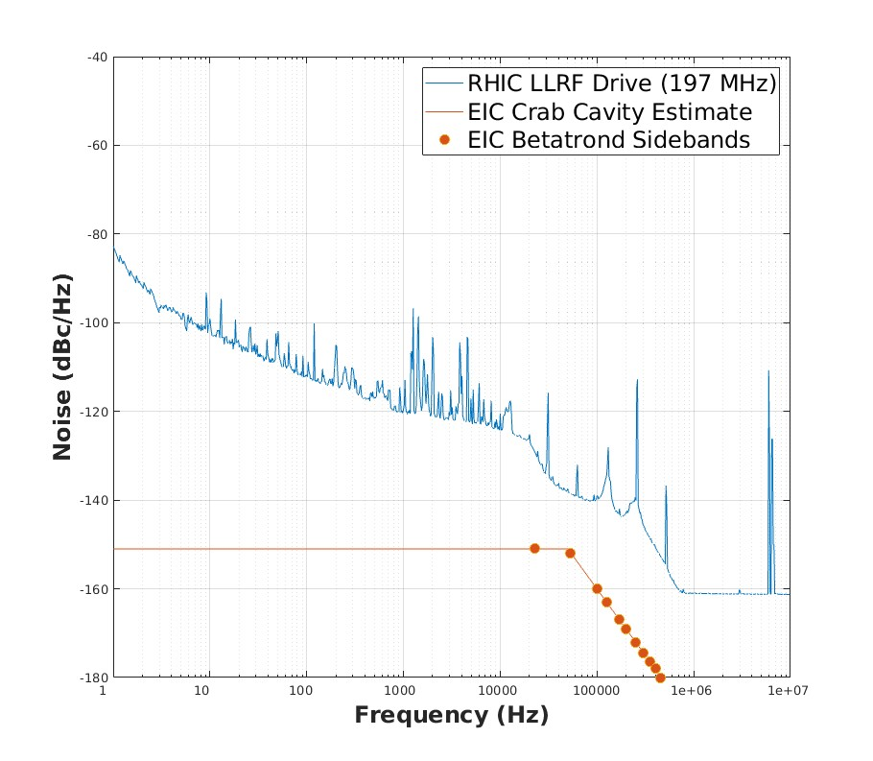
RF Noise Specification: Crab RF Systems
RF Noise (Field regulation):
RF noise increases the transverse emittance which reduces the luminosity.
Phase noise kicks leads to a shift on bunch centroid position.
Amplitude noise leads to a rotation of the bunch.
The sensitivity of RF noise is particularly high in the HSR Crab RF systems.
This is the most challenging aspect of the Low-Level RF design.
The RF noise threshold for the HSR will be very hard to achieve technologically
LLRF Design Requirements:
The target phase noise was set @ < -151 dBc/Hz integrated +/- 1 kHz around each betatron sideband.
This noise level is at the limit of current state of the art.
RF Noise feedback is required:
A noise cancelation system will also be required achieve the emittance growth rate target due to RF noise equal to the IBS growth rate expected which about 1 / 2 hr for 275 GeV.

Slide 11
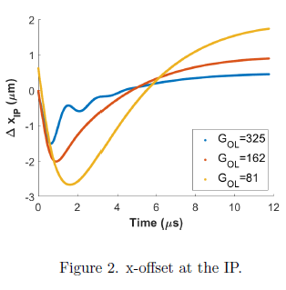
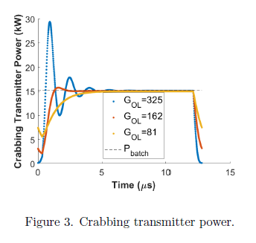
Other Crab RF Specification
Themis Mastoridis
Expected transient beam loading effects [5]:
Residual offset on beam transverse position.
Reduce luminosity.
Higher RF power amplifier peak power (Gain)
The transient beam loading in crabs leads to very small effect on ∆XIP [5].
Strict regulation (Amplitude / Phase):
0V set-point during injection, ramping.
Ramp-up voltage at Store.
Vector sum regulation.
Crabbing vs Un-crabbing voltage & phase

Slide 12
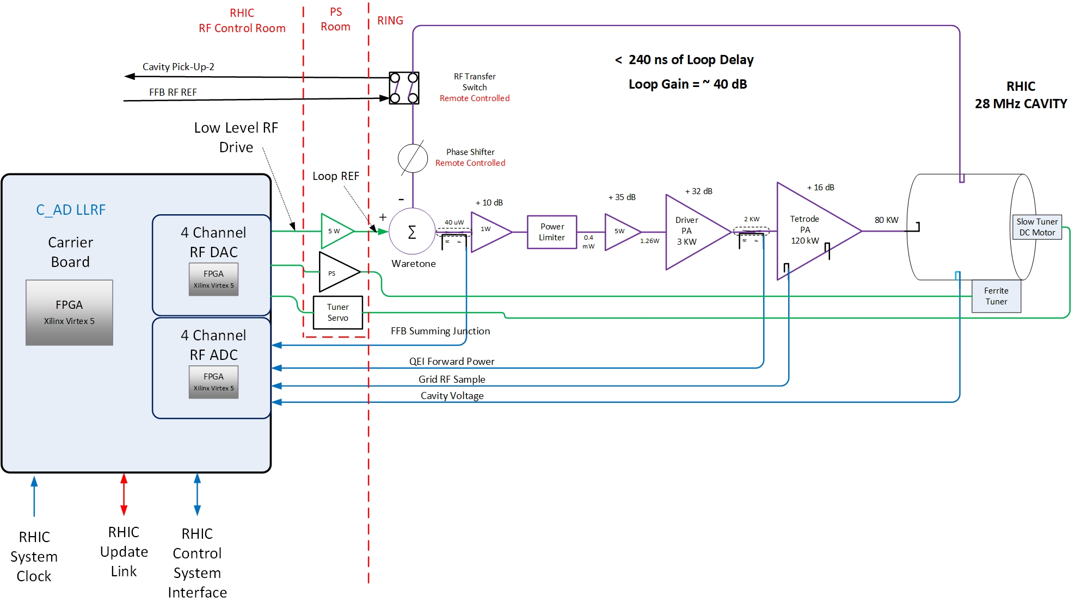

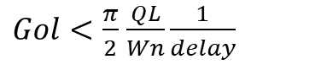
RF Field Control Based on RHIC LLRF
RHIC RF Systems (28 MHz & 197 MHz) NCRF:
Capture, Acceleration and Store in RHIC.
Field control feedback loop:
Digital Low-Level RF Controller
NCO FPGA
RF DAC
RF ADC
Digital LLRF feedback for long term stability
Analog direct RF feedback
46 dB of gain (x200) for impedance reduction.
Gain is limited by Cavity parameter & Loop delay.
Resonance control:
Fast ferrite tuner (28 MHz)
Slower mechanical tuner for acceleration ramp.
A Vector Network Analyzer (VNA) is used for setting up direct feedback loop stability.
Field regulation and phase noise are primarily determined by the quality of the LLRF drive (Loop Reference).
$Gol<\frac{π}{2}$ $\frac{QL}{Wn}\frac{1}{delay}$
$z_{eq}$(j$ω)= \frac{z_{cav}(jω)}{1+Gol(jω)}$

Slide 13
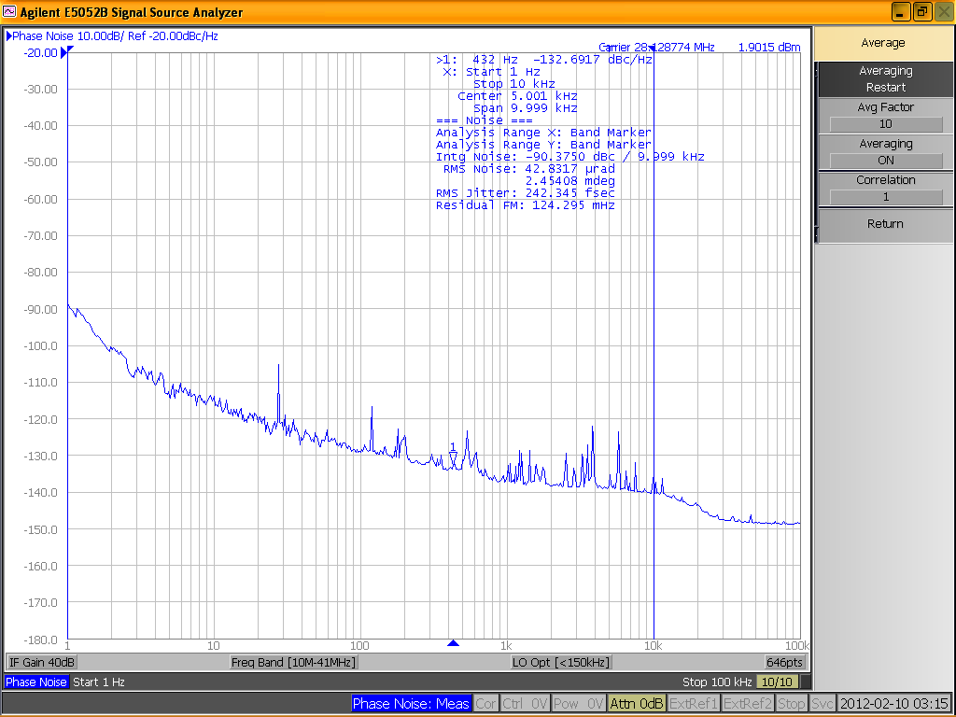

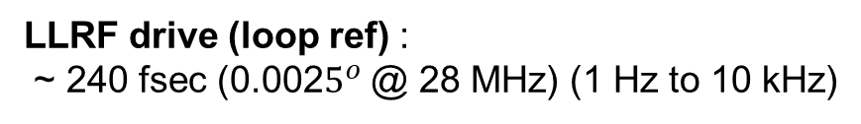
C-AD LLRF (Field Regulation)
RF Field noise on 28 MHz cavity with 46 dB of direct-feedback gain:
Phase noise on cavity field identical to noise out from LLRF RF drive.
No measurable difference was found for all other RHIC RF systems.
LLRF drive (loop ref) :
~ 240 fsec (0.002$5^{o}$ @ 28 MHz) (1 Hz to 10 kHz)
Cavity field :
~ 240 fsec (1 Hz to 10 kHz)

Slide 14
EIC Low-Level RF Control hardware overview
LLRF design is based on the EIC common platform hardware design
Common general purpose carrier
Function-specific daughtercards
Common timing data link Line rate 8 Gbps​
Standard control system interface
100 MHz Master Clock
EIC common platform hardware is an evolution of RHIC Low-level RF platform used in C-AD since 2009.
FPGA based carrier card
Gigabit serial link (deterministic / low-latency) timing and data communication
Use function-specific daughtercards
Major Hardware Components:
Analog Up/Down Converter & LO Generation
Low-Level RF daughter cards (RF ADC/RF DAC)
Resonance & Interlock Design
Common platform carrier
Extended Carrier
Timing data link (TDL)
Digital IO Card
Based band ADC
Kevin Mernick

Slide 15
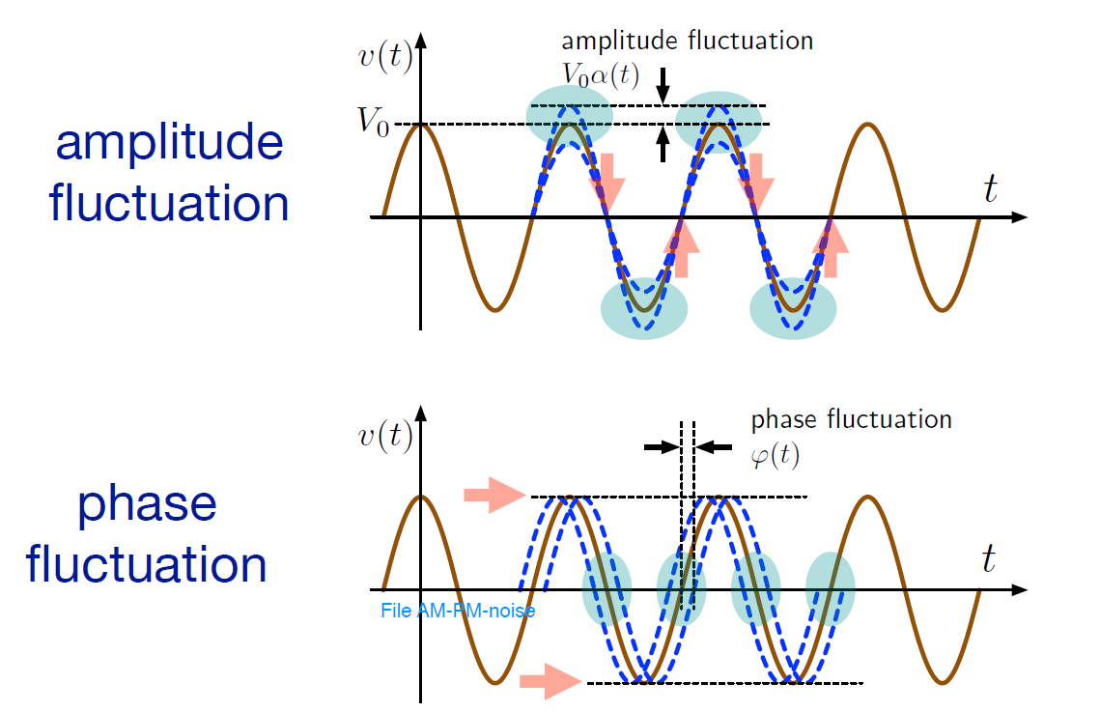
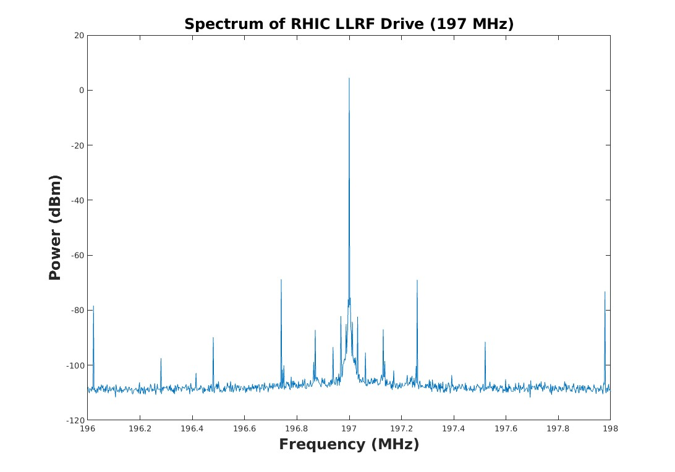
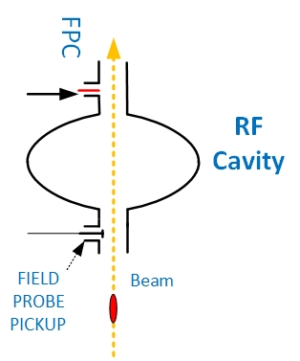
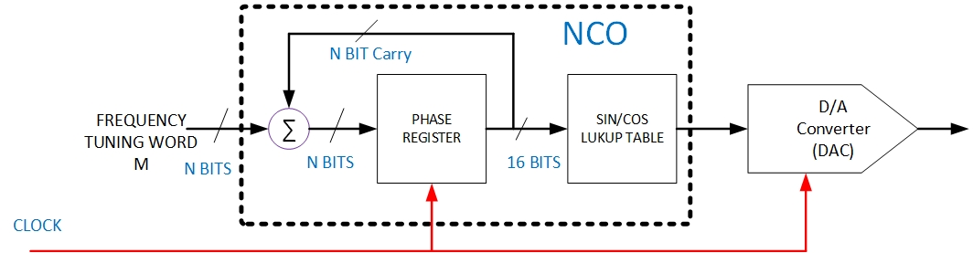
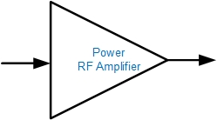
Perturbations on real world RF system
Low-Level RF:
Master clock phase noise.
Clock jitter, nonlinearity on components.
DAC & ADC additive jitter.
Crate power supply ripple.
High Power RF:
Additive noise.
Amplifier power supply ripple.
Amplifier Nonlinearities.
Cavity:
Microphonics induce detuning.
Lorentz force detuning.
Thermal effects (Quenching).
Field Multipacting.
Beam induced:
HOMs, wake-field.
Changes on beam spectrum.
Transient beam loading.
Cross-talk between signals.
Temperature drift.
𝑉(𝑡)) = 𝑉𝐶𝐴𝑉[1 + α(𝑡)] × sin⁡[𝜔𝑅𝐹(𝑡) + ϕ(t)]
Direct Digital Synthesis (DDS)
RF Amplifier

Slide 16
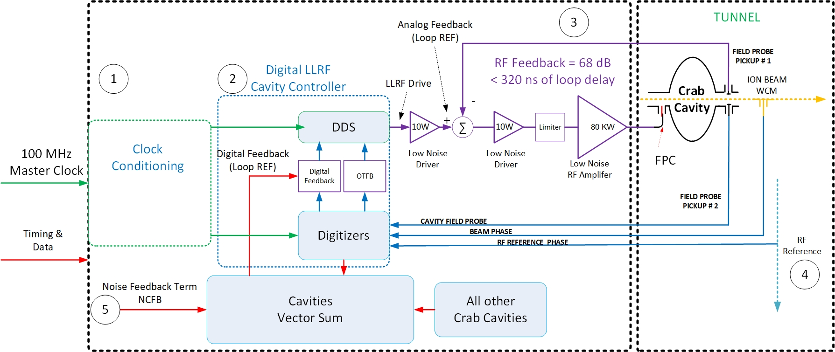
EIC Crab Cavity Low-Level RF Solution
Design effort focus in five areas:
Master clock (RF Noise)
Generation
Distribution
Conditioning
Digital Controller (RF Noise)
Low Noise LLRF drive (DDS).
Low Noise Digitizer (RF ADC)
OTFB reduce impedance (20dB)
Cavity protection (Quench)
Vector Sum Control
Cavity trip recovery
Direct-rf feedback (RF Noise).
Reduce Impedance (Gain = 68 dB)
Low-Noise vs High-gain.
RF Amplifiers RF Noise/Linearity.
Power Limiter.
Cavity quench protection
Each side of IR6
Phase reference line.
Beam phase pickup.
Head/Tail measurement system (Instrumentation):
Noise cancelation FB Term
Crabbing closure term
Multi-ADCs (Noise)
Cable bundle
Notes:
Crab Cavities Building (keep delay short).
Crabbing closure term from Head/Tail measurement high precision BPMs and ADCs (Manfred, Dave, Themis)

Slide 17
Master Clock Distribution
IR10: Clock Receiver, Clean-Up, Drift Comp
Crabs
Crabs
100 MHZ Master Clock Generation
Crabs
17

Slide 18
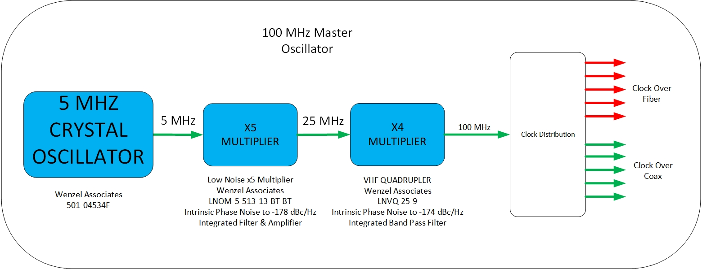
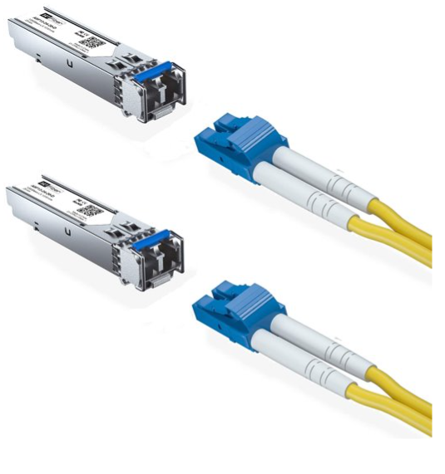
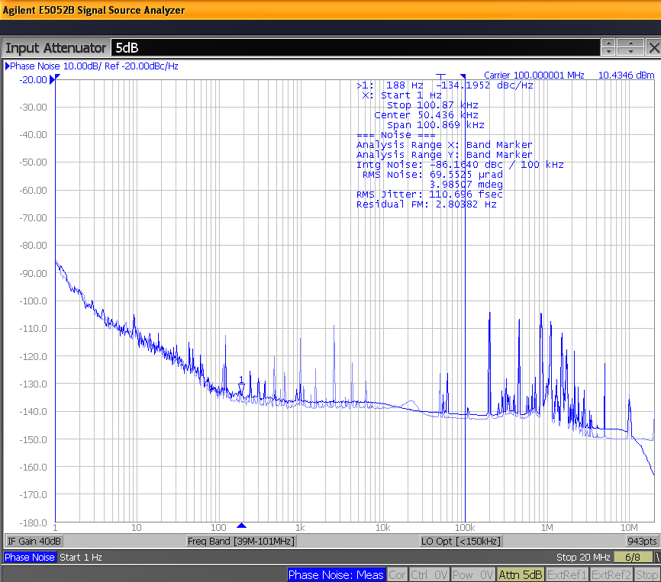
RHIC Master Clock
RHIC Master Clock
RF Phase noise RHIC Master Clock
Good close-in phase noise ~100 fsec rms jitter (1 Hz to 100 kHz)
RHIC Master clock phase noise mostly preserved when transmitted over fiber.
-150 dBc/Hz noise floor limit on fiber transition/recovery is acceptable for RHIC but not sufficient for EIC Crab RF Systems.
18

Slide 19
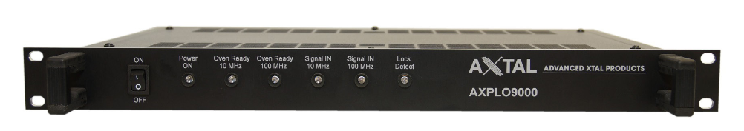
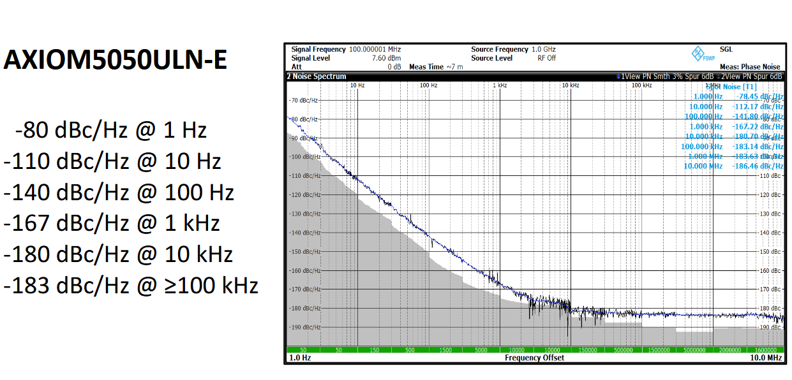
EIC Master Clock
EIC Master Clock source:
Very-Low Phase Noise (close-in and noise floor)
RMS Jitter: better than 50 fsec (1 Hz to 100 MHz)
Thermally stabilized
GPS Disciplined Rubidium Oscillator
Commercially available
Distribution over fiber to each service building
Timing Data Link system
19

Slide 20
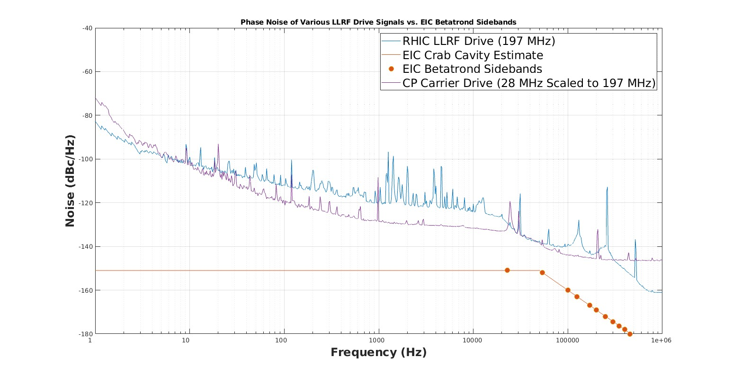
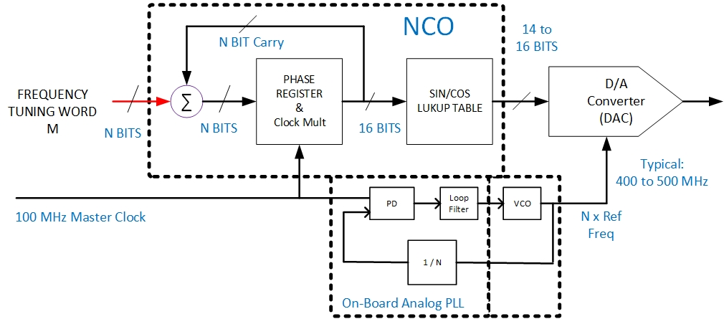
LLRF Digital Controller: DDS
Most modern Low-Level RF implement Direct Digital Synthesis (DDS):
FPGA based numerical controlled oscillator (NCO)
Integrated PLL for clock clean up (RHIC,EIC)
On Board High Frequency VCO
On Board PLL IC (RHIC AD9510, EIC CP LTC6952)
Selectable Clock Output Frequency
Low Cost (every board)
Digital to Analog Converter (DAC)
Low latency, 16 Bits parallel interface (feedback)
Older technology
Good trade-off noise performance, clock speed & latency
RHIC DAC (MAX5891) - 600 MSPS
EIC CP DAC (AD9783) most applications – 500 MSPS
RHIC LLRF @ 197 MHz (AD9510 PLL & MAX5891)
EIC CP DAC @ 197 MHz (LTC6952 PLL & AD9783)
20
Notes:
1) Far from target using RHIC LLRF or Common platform DAC & New On-Board PLL.

Slide 21
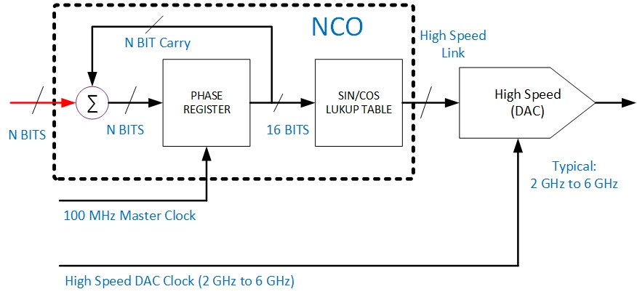
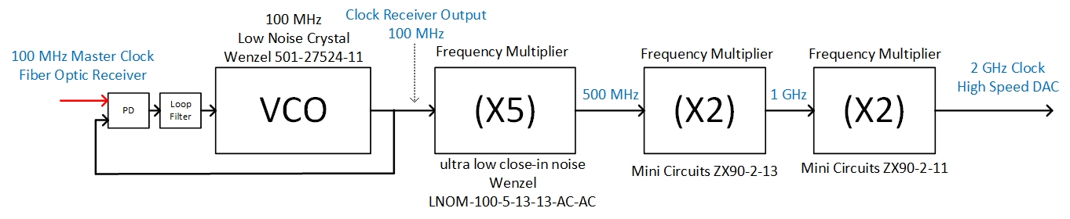
LLRF Digital Controller: Crabs DDS
EIC Crab Cavity Low-Level RF:
FPGA based numerical controlled oscillator (NCO)
Digital to Analog Converter (DAC)
High Speed RF DAC (AD9164): 16 Bits, 12 GSPS
New technology
Improved phase noise performance vs parallel DACs
Requires High Speed Clock
Dedicated Clock Receiver Board
Ultra-low Noise 100 MHz VCO
Low-Noise clock multipliers
Low-Bandwidth Lock to reference clock
One for each (Crab building)
21
Notes:
One high end VCO for clock recovery, Up to 2 for each crab cavity building.

Slide 22
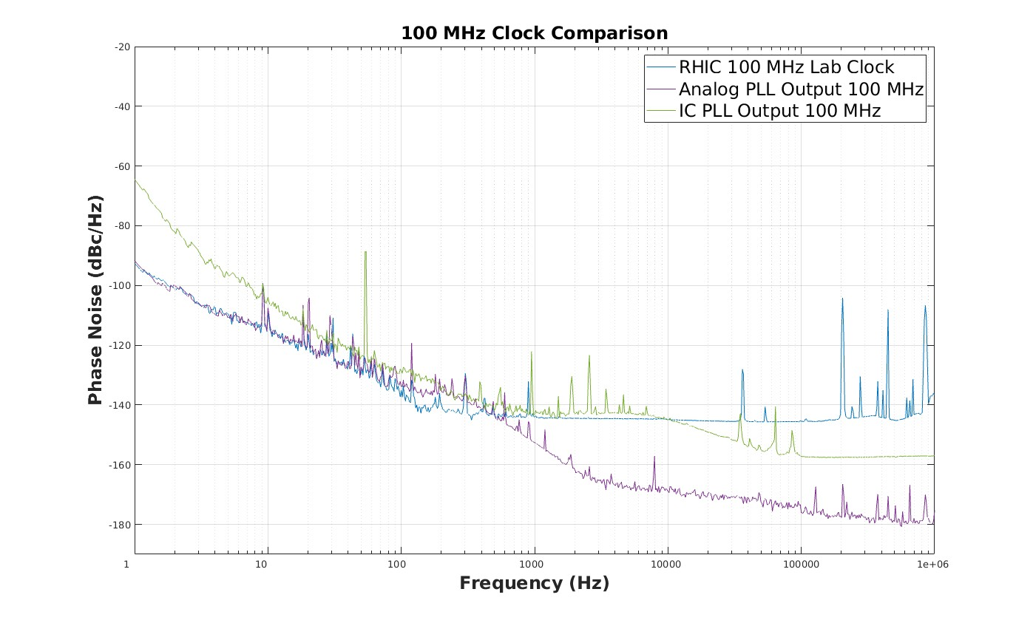
Crabs DDS: External clock receiver PLL
EIC Crab Cavity Low-Level RF:
FPGA based numerical controlled oscillator (NCO)
Digital to Analog Converter (DAC)
High Speed RF DAC (AD9164): 16 Bits, 12 GSPS
New technology
Improved phase noise performance vs parallel DACs
Requires High Speed Clock
Dedicated Clock Receiver Board
Ultra-low Noise 100 MHz VCO
Low-Noise clock multipliers
Low-Bandwidth Lock to reference clock
One for each (Crab building)
c/o M. McCooey
22
Notes:
One high end VCO for clock recovery, Up to 2 for each crab cavity building.

Slide 23
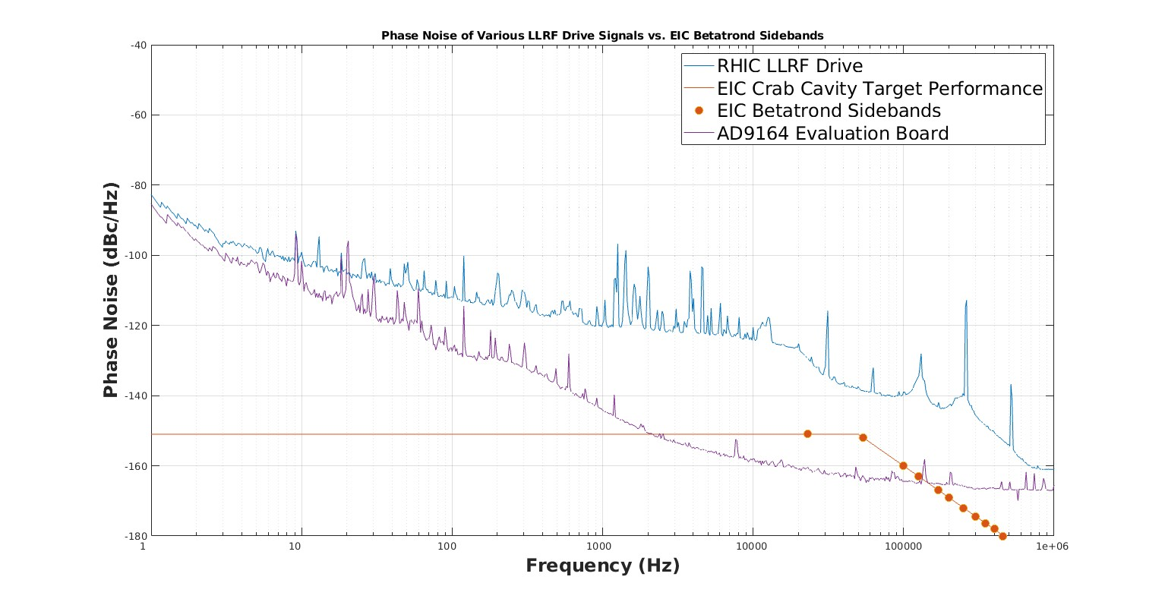
Crabs DDS Preliminary Results
Preliminary results LLRF Drive:
Hardware Setup:
High speed DAC (AD9164) Eval board
RHIC 100 MHz Master clock (Tx Fiber)
Clock Receiver Board
Ultra-low Noise 100 MHz VCO
Low-Bandwidth Lock to reference clock
Low-Noise Clock Multipliers
2 GHz Clock to DAC Eval
Lab Results:
RF noise is on target requirement Crabs LLRF Drive
~50 fsec 1Hz to 10 kHz
~6 fsec 10 kHz to 1 MHz
Further improvements planned final design:
Select better clock multiplier (Wenzel vs Mini Circuits)
Improve board regulator design
Combine multiple DDS outputs
Doubling DSS (3 dB improvement).
c/o M. McCooey & S. Mai
23

Slide 24
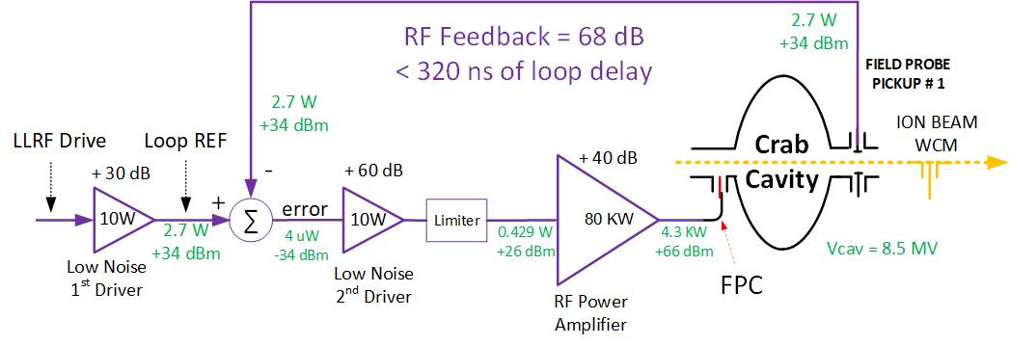
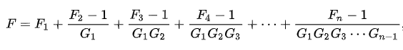
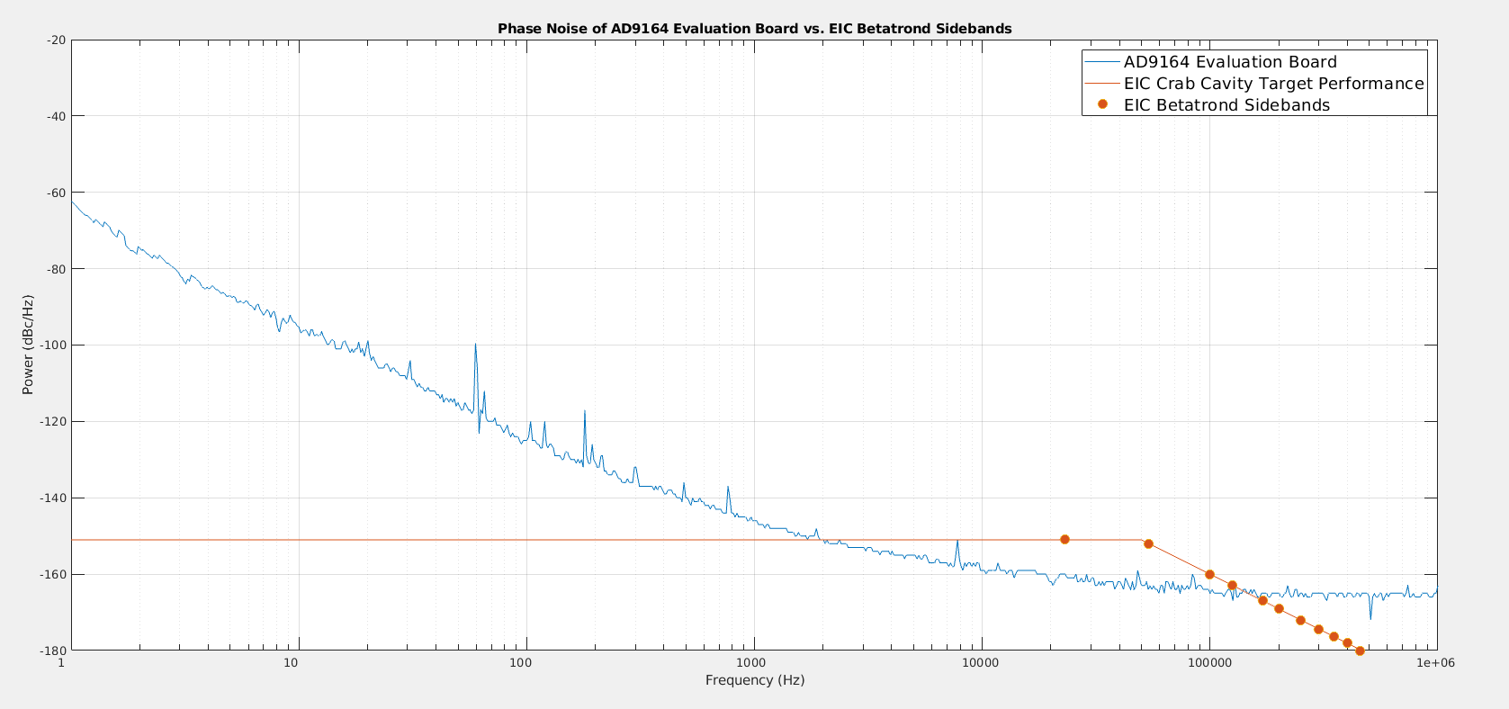
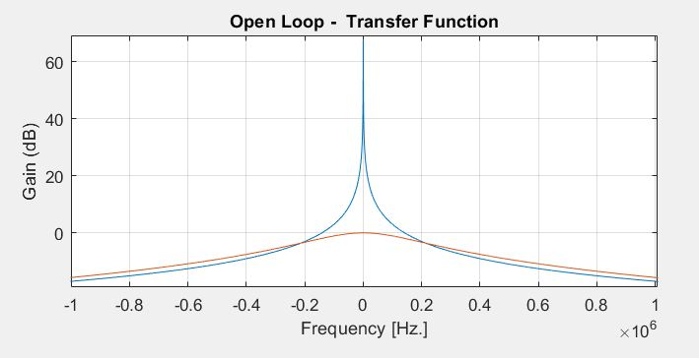
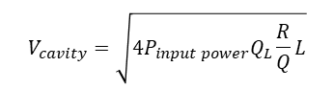
Direct-rf feedback (RF Noise)
Direct-rf feedback RF noise:
Feedback gain 68 dB (6000)
Much higher than RHIC systems (@46dB)
RF Amplifier chain gain 100 dB (x 100 K)
Similar to RHIC 197 MHz (@ 93 dB)
Driver Amplifiers noise factor is more critical
RF chain noise factor is primarily established by noise figure of its first amplifying stage.
Friis’s Formula:
1st Driver noise becomes loop reference
Filtered by Cavity closed response.
Feedback corrects in-band noise.
2nd Driver noise is amplified (OL)
Signal closer to noise floor
Filtered by Cavity Open Loop
High Power RF Amplifier design
Design in house (RHIC 197 MHz)
Linearity
Regulators
Under evaluation
$$V_{cavity}=\sqrt{4P_{input power}Q_{L}\frac{R}{Q}L}$$
Open Loop TF
Closed Loop
68 dB
250 ns loop delay
LLRF Drive / Loop Ref
Cavity RF noise reduced CL (~10dB)
Notes:
Amplifier chain forward gain is similar to that of the RHIC 197 MHz (93 dB vs 100 dB) (Ratio FPC Power to Pickup Power)
The feedback enforces RF noise on the loop reference (within loop Bandwidth).
Noise on the reference is only filtered by Closed loop response.
Noise on amplifier inside the loop is filtered by cavity open loop response.
Very Low noise Figure driver amplifiers are available used for clock distribution applications

Slide 25
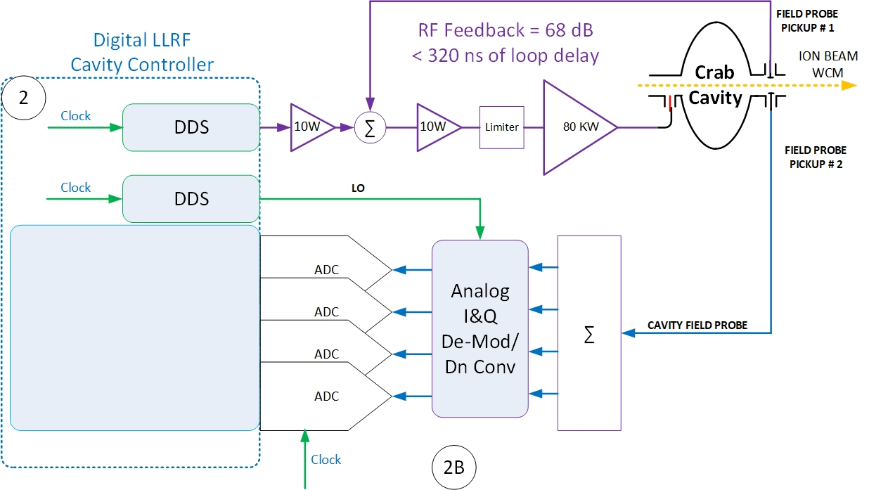
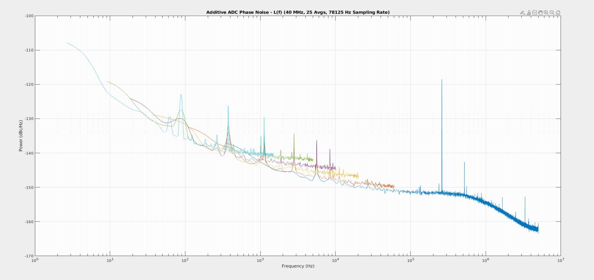
OTFB (RF Noise): Digitizer
OTFB Implementation:
Implemented on the FPGA.
Wide band to cover many revolution line.
Track betatron frequencies during the ramp.
RF ADC additive noise is a concern
Typical : ~ 77 dB SNR @ 125 MSPS
Additive noise ~ - 152 dBc/Hz
Matlab Script developed by CAD LLRF Engineer : Michael McCooey
OTFB:
Double Comb
Betatrond Side band
RHIC RF ADC ~ -152 dBc/Hz
OTFB RF ADC Noise Improvement:
EIC RF ADC design in progress
Provide direct clock (on-Board PLL bypassed)
Down Convert &/or Analog I&Q demodulator (Improves Noise)
Average multiple ADC channels
RF ADC Phase Noise Measurement (RHIC RF ADC)

Slide 26
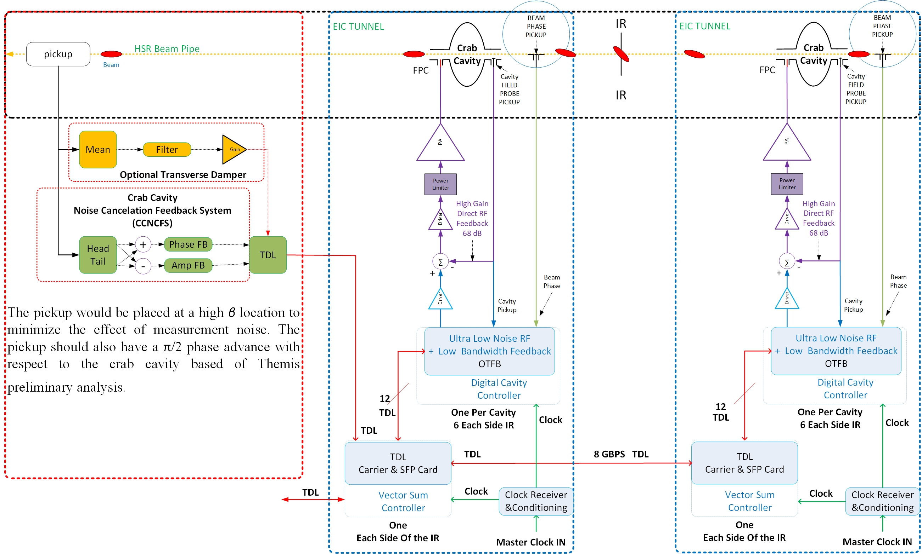
Crab Cavity LLRF: Hardware
HL RF Trip:
Beam Permit
EIC Instrumentation
Noise cancelation feedback system:
Dedicated high precision beam pickup
Reduce RF systems noise
Correct Crabbing vs Un-crabbing decidual error
Vector Sum Controller restores voltage/phase on each side of the IR (May pull beam permit)

Slide 27
Summary & Status
Design effort focus in five areas:
Master clock (RF Noise)
Generation
Distribution
Conditioning
Digital Controller (RF Noise)
Low Noise LLRF drive (DDS).
Low Noise Digitizer (RF ADC)
OTFB reduce impedance (20dB)
Cavity protection (Quench)
Vector Sum Control
Cavity trip recovery
Direct-rf feedback (RF Noise).
Reduce Impedance (Gain = 68 dB)
Low Noise RF Driver Amplifier.
RF Amplifiers RF Noise/Linearity.
Power Limiter.
Cavity quench protection
Each side of IR6
Phase reference line.
Beam phase pickup.
Head/Tail measurement system (Instrumentation):
Noise cancelation FB Term
Crabbing closure term
Demonstrated solution meets requirements (operational or evaluation board)
In progress
Multi-DACs (Noise)
Multi-ADCs (Noise)
Cable bundle
Notes:
Crab Cavities Building (keep delay short).
Crabbing closure term from Head/Tail measurement high precision BPMs and ADCs (Manfred, Dave, Themis)

Slide 28
Acknowledgements
JLab & BNL (EIC & C-AD) RF teams (former and present).
Michael McCooey , Geetha Narayan, Kevin Mernick, Arshdeep Singh
Samson Mai, Mark Hoffmann Wallner, Alex Zaltsman, Michael Sowinski
Binping Xiao, Silvia Verdu Andres and many others
Special thanks to Michael McCooey for his work on clock recovery/clean-up and RF noise measurements
Michael Blaskiewicz provided Accelerator Physics support.
Themis Mastoridis for his support providing analysis of RF systems challenges.
Thank You !
Questions ?

Slide 29
References
[1] F. Willeke et al., “Electron-Ion Collider conceptual design report,” BNL, Upton, NY, USA, Feb. 2021.
[2] M. Blaskiewicz, Instabilities Driven by the Fundamental Crabbing Mode, BNL Tech Note BNL-222221-2021-TECH
[3] T. Mastoridis, M. Blaskiewicz, and T. Loe, Eic transverse instabilities due to the crab cavity fundamental impedance, Accepted for publication to Phys. Rev. Accel. Beams (2024).
[4] K. Smith, T. Mastoridis, P. Fuller, P. Mahri, and Y. Matsumura, EIC transverse emittance growth due to crab cavity RF noise: Estimates and mitigation,, BNL-222748-2022-TECH
10.2172/1846026 (2022).
[5] T. Mastoridis, etc all, “Time-domain simulation of the crab cavity/beam interaction ”, BNL Tech Note BNL-224087-2023-TECH EIC-ADD-TN-039.

Slide 30
Themis:
#11, Power for zero voltage set-point during the energy ramp
What is new compared to RHIC: Noise req, High Q cavity with Higher gain.
Can we fix the bandwidth or make it changeable (Gain changes)
OTFB loop we could turn-it off at Store to keep noise off.

Slide 31
Questions

Slide 32
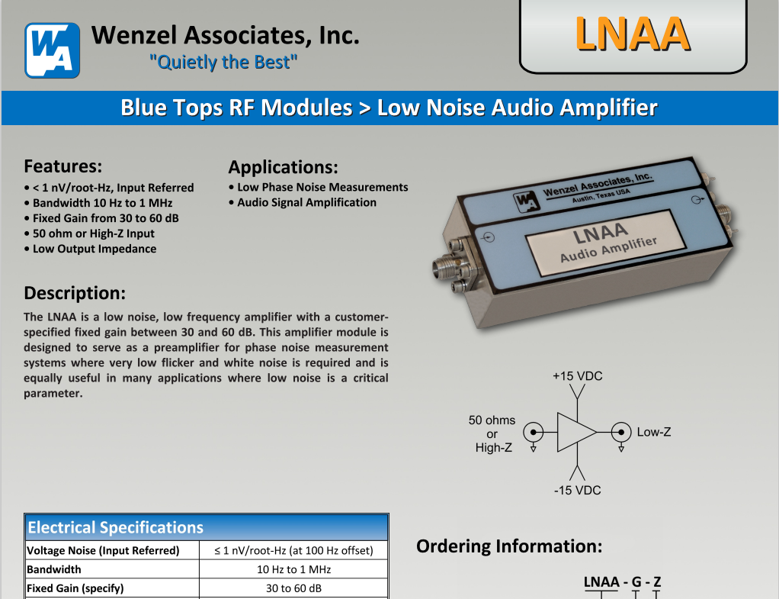
Backup Slides

Slide 33
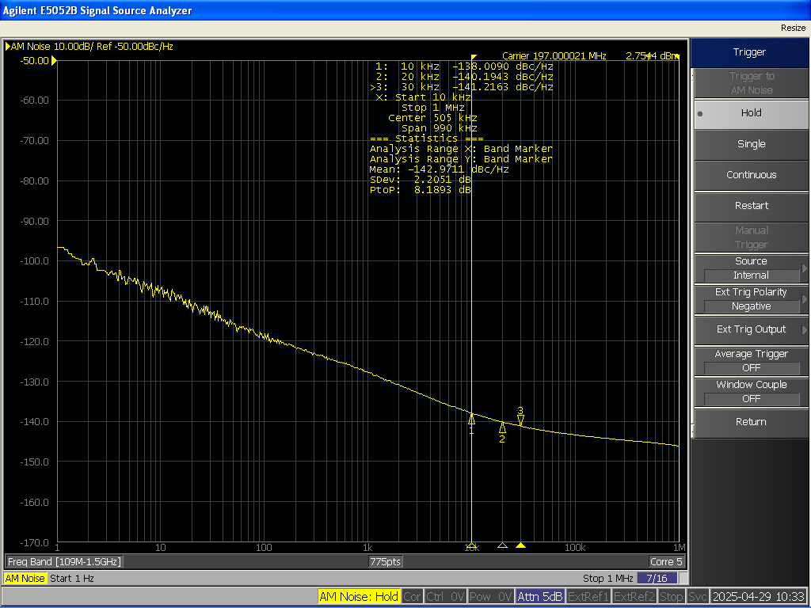
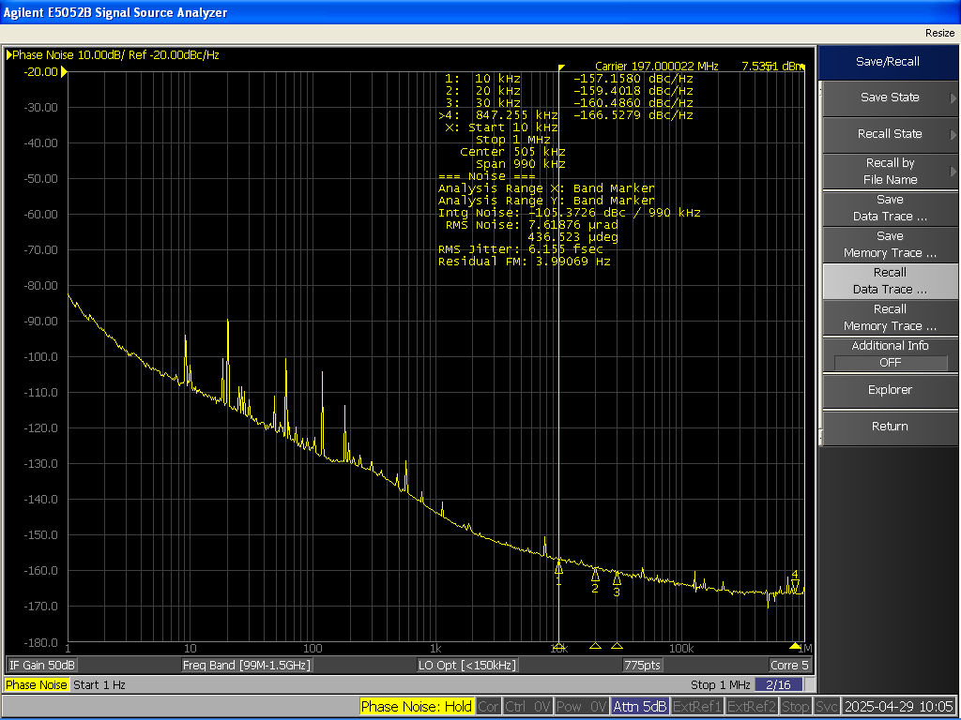
Amplitude Noise AD9164 Eval Board

Slide 34




Low Level RF Controller: Functions
Core LLRF functions:
Generates LLRF Drive.
Regulates Cavity RF field’s amplitude and phase.
Resonance control.
Cavity protection.
Provides control system interface.
Provides calibrated measurements of all cavities waveform (Forward, Reflected, Probe).
LLRF Interacts:
High Power RF
Couplers
Cavity and Cavity tuners
Cryogenics
Controls
Cooling Systems
Beam
Experiments
Cavity as an Electrical System
𝑉(𝑡)) = 𝑉𝐶𝐴𝑉(𝑡) × sin⁡[𝜔𝑅𝐹(𝑡)]
2nd Order Band-pass
filter

Slide 35


RF phase Noise: Move to back-up
Phase noise is the frequency-domain representation.
Short-term random fluctuations in the phase of a signal.
Spreads out equally on either side of the carrier but only one side is measured.
While specifying phase noise, three elements need to be specified:
1. Phase Noise Amplitude: It is expressed in dB relative to the carrier. This is normally denoted in dBc/Hz, e.g. -70 dBc - 70 decibels down in level from the carrier.
2. The offset from the carrier: Ex. 1 kHz, 10 kHz, 100 kHz.
3. Measurement bandwidth: Noise power is proportional to the bandwidth so it should be always mentioned. Typically 1 Hz is taken as the bandwidth.

Slide 36
Crab RF Specification: Field Regulation ??
The stability requirement varies in different accelerator.
The requirement on amplitude / phase stability differs by time scale, short term, medium term, long term (minutes to hours). It is often specified as an rms value but peak to peak is also used.
HSR Crab Systems stability requirements? Under development
Target (HSR 275 GeV) →
 | XFEL (RF 1.3 GHz) | ILC (RF 1.3 GHz) | SNS (RF 402.5 MHz) | JPARC Multiple | CeCPoP Multiple
Amplitude/Phase Stability | 0.01%, 0.0$1^{o}$ (rms) | 0.1%, 0. $1^{o}$ (rms) | $±$0.5%, $±$ 0.$5^{o}$ | $±$1%, $±1^{o}$ | 0.01%, 0.$1^{o}$ (rms)
 | HSR 275 GeV (197 MHz Crab)
Amplitude/Phase Stability | ~0.001%, ~0.000$1^{o}$ (rms) Integrated +/- 1kHz around each betatron sideband offset from carrier

